Slide 1
CS 540 Network Architecture
Lecture 17 : IoT Networking
Prof. Younghee Lee

Slide 2
IoT Group survey

Slide 3
Contents
AllSeen Alliance
Open Interconnect Consortium (OIC)
Thread Group
Industrial Internet Consortium (IIC)

Slide 4

AllSeen Alliance
An Open Source project building the framework for the internet of Things (IoT)
LG, MS, ….
The Internet of Everything is based on the idea that devices, objects and systems can be connected in simple, transparent ways to enable seamless sharing of information across all of them.

Slide 5
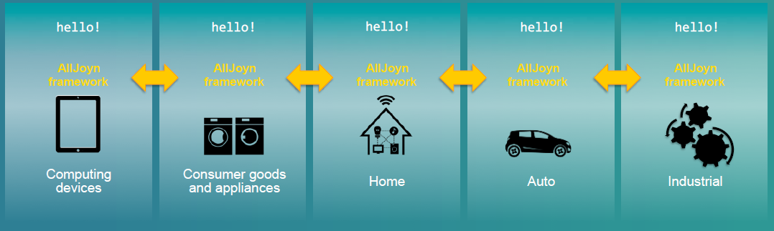
AllSeen Alliance
Connect, manage and interoperate across brands, categories, bearers, transports and OS

Slide 6
AllSeen Alliance
The AllSeen Alliance framework is initially based on the AllJoyn™ open source project, and will be expanded with contributions from member companies and the open source community.
AllJoyn open source project can communicate over various transport networks, such as Wi-Fi, power line or Ethernet, regardless of manufacturer or operating system and without the need for Internet access.
runs on popular platforms such as Linux and Linux-based Android, iOS, and Windows, including embedded variants.

Slide 7
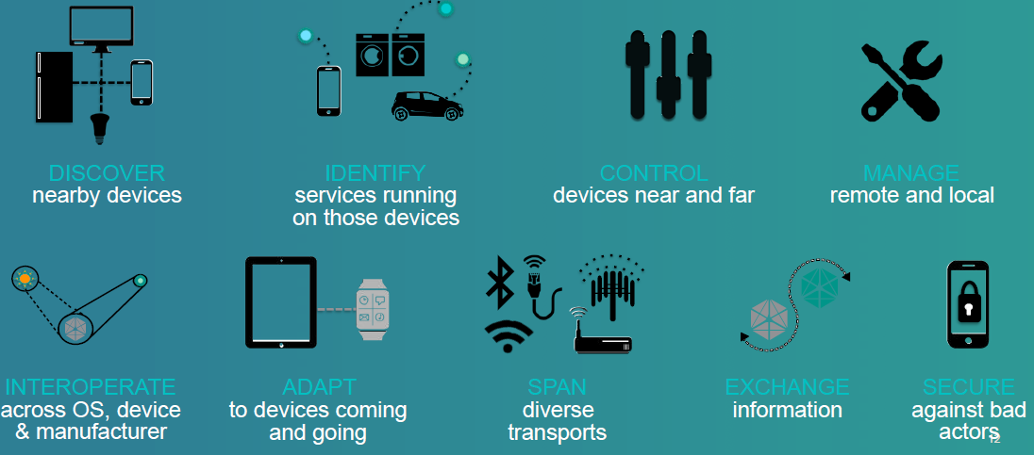
AllSeen Alliance
AllJoyn solves the problems in an open interoperable way

Slide 8
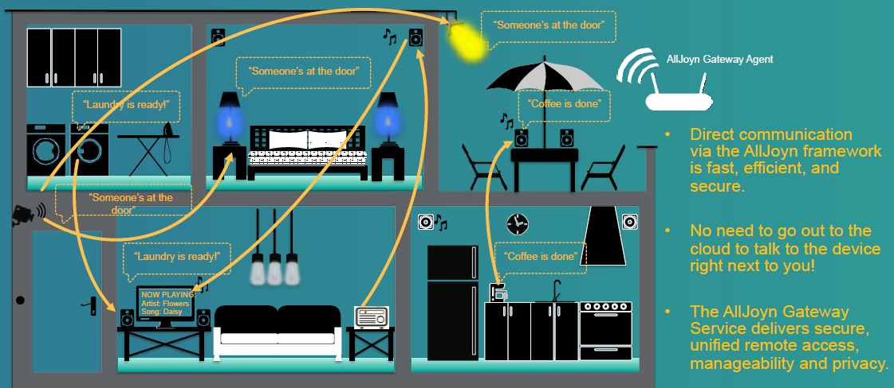
AllSeen Alliance
The AllJoyn enabled use case

Slide 9
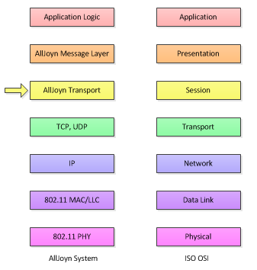
AllSeen Alliance
AllJoyn solves the problems in an open interoperable way
Notes:
AppId, AppName, DeviceName, DeviceId, Manufacturer, ModelNumber

Slide 10
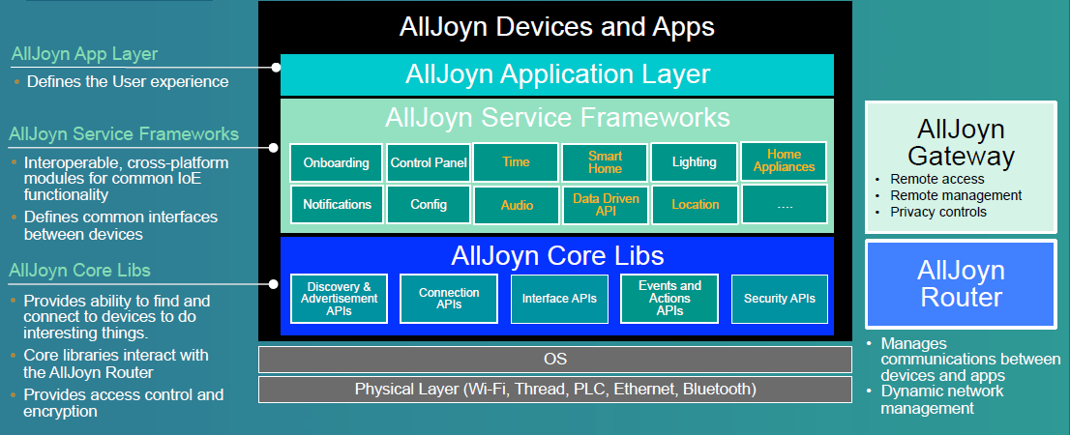
AllSeen Alliance
AllJoyn Software Framework: High-level architecture
D-bus

Slide 11

Open Interconnect Consortium (OIC)
The Open Interconnect Consortium (OIC) will define the connectivity requirements to improve interoperability between the billions of devices making up the Internet of Things (IoT).
CISCO, Intel, Samsung, ETRI, KAIST, SNU …
The OIC will deliver a specification, an open source implementation and a certification program ensuring interoperability regardless of form factor, operating system, service provider or transport technology creating a "Network of Everything".
The OIC invites the industry : Automotive, Consumer Electronics, Enterprise, Healthcare, Home Automation, Industrial and Wearables, amongst others.

Slide 12
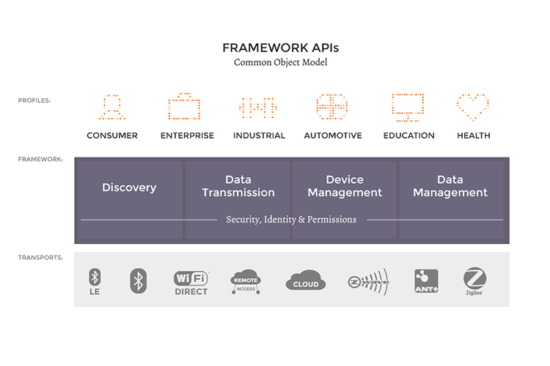
Open Interconnect Consortium (OIC)
The IoTivity is an open source software framework enabling seamless device-to-device connectivity.
The IoTivity project is sponsored by the OIC & LINUX foundation.

Slide 13
Open Interconnect Consortium (OIC)
The IoTivity framework APIs are based on a resource-based, RESTful architecture model.
The framework operates as middleware across all operating systems(Linux, Arduino, Tizen) and connectivity platforms and has four essential building blocks:
Discovery IoTivity discovery supports multiple discovery mechanisms for devices and resources in proximity and remotely. ➔ CoAP Model
Data transmission IoTivity data transmission supports information exchange and control based on a messaging and streaming model.
Data Management IoTivity data management supports the collection, storage and analysis of data from various resources.
Device management IoTivity device management supports configuration, provisioning and diagnostics of devices.
https://www.iotivity.org/documentation/features

Slide 14
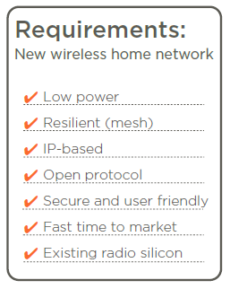

Thread Group
Thread was designed with one goal in mind: To create the very best way to connect and control products in the home.
ARM, Samsung, Nest,…
Designed specifically for the home
Robust self-healing mesh network
No single point of failure
Interoperable by design using proven, open standards and IPv6 technology with 6LoWPAN as the foundation
Requires just a software enhancement for today’s 802.15.4 products

Slide 15
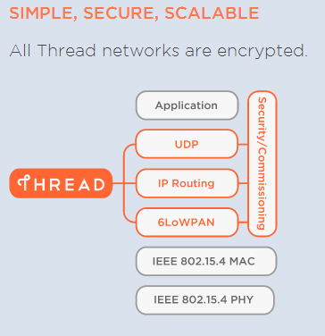
Thread Group
Simple installation using your smartphone, tablet or computer
Scalable to connect 250+ devices into a single network supporting multiple hops
Provides security at network and application layers
Product install codes are used to ensure only authorized devices can join the network
Supported by banking-class, public-key cryptography

Slide 16

oneM2M
: Standards for M2M and the Internet of Things
OneM2M is the leading global standardization body for M2M and IoT. It was established through an alliance of standards organizations to develop a single horizontal platform for the exchange and sharing of data among all applications.
to develop technical specifications which address the need for a common M2M Service Layer that can be readily embedded within various hardware and software, and relied upon to connect the myriad of devices in the field with M2M application servers worldwide.
A critical objective of oneM2M is to attract and actively involve organizations from M2M-related business domains such as: telematics and intelligent transportation, healthcare, utilities, industrial automation, smart homes, etc. Initially, oneM2M shall prepare, approve and maintain the necessary set of Technical Specifications and Technical Reports for:
-Use cases and requirements for a common set of Service Layer capabilities;
-Service Layer aspects with high level and detailed service architecture, in light of an access independent view of end-to-end services;
-Protocols/APIs/standard objects based on this architecture (open interfaces & protocols);
-Security and privacy aspects (authentication, encryption, integrity verification);
-Reachability and discovery of applications;
-Interoperability, including test and conformance specifications;
-Collection of data for charging records (to be used for billing and statistical purposes);
-Identification and naming of devices and applications;
-Information models and data management (including store and subscribe/notify functionality);
-Management aspects (including remote management of entities); and
-Common use cases, terminal/module aspects, including Service Layer interfaces/APIs between:
-Application and Service Layers;
-Service Layer and communication functions

Slide 17
oneM2M (one Machine to Machine)
: Standards for M2M and the Internet of Things
oneM2M FOUNDING PARTNERS
ARIB (Association of Radio Industries and Businesses) – Japan
ATIS (Alliance for Telecommunications Industry Standards) – USA
CCSA (China Communications Standards Association) – China
ETSI (European Telecommunications Standards Institute) – Europe
TIA (Telecommunications Industry Association) – USA
TTA (Telecommunications Technology Association) – Korea
TTC (Telecommunications Technology Committee) – Japan

Slide 18
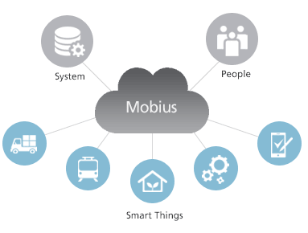
oneM2M (one Machine to Machine)
: Standards for M2M and the Internet of Things
Benefits of oneM2M
Enables Simplified M2M App development by abstracting out access specific interfaces
All M2M Apps can benefit from integrated qualities: secure, efficient, scalable etc.
M2M App developers can leverage the Underlying Network’s capabilities in a unified way
Easier to use a wider range of Underlying Network
Mobius : oneM2M 표준 기반의 개방형 IoT 플랫폼 (sk텔레콤)

Slide 19
OASIS
OASIS promotes industry consensus and produces worldwide standards for security, Internet of Things, cloud computing, energy, content technologies, emergency management, and other areas.
IBM, Microsoft,…
MQTT

Slide 20
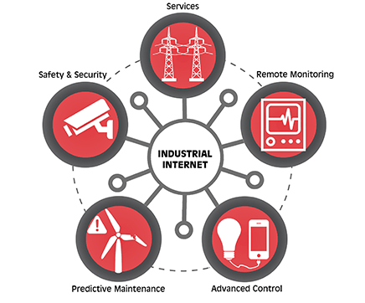

Industrial Internet Consortium (IIC)
The Industrial Internet Consortium (IIC) was founded in March 2014 to bring together the organizations and technologies necessary to accelerate growth of the Industrial Internet by identifying, assembling and promoting best practices.
AT&T, Cisco, GE, IBM and Intel…

Slide 21
Industrial Internet Consortium (IIC)
This goal of the IIC :
Drive innovation through the creation of new industry use cases and testbeds for real-world applications;
MQTT
The Industrial Internet will have a huge impact in nearly every industry.
Energy & Utilities, Healthcare, Manufacturing, Public Sector, Transportation

Slide 22
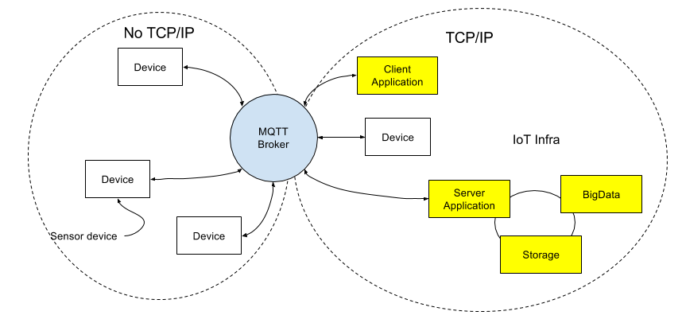
Message Queue Telemetry Transport (MQTT)
A publish-subscribe based "light weight" messaging protocol for use on top of the TCP/IP protocol
MQTT-SN: for embedded devices on non-TCP/IP networks, such as ZigBee
Facebook Messenger…

Slide 23
The Message System Paradigm
receivers
message system
Storage and management of subscriptions
sender
...
Notify
Publish
Suscribe/ Unsubscribe
Notify
Publish
...
Suscribe/ Unsubscribe
broker
Event Service
subscribers
publishers
The Publish/Subscribe Message Model
Each message is associated with a specific topic or event.
Applications interested in the occurrence of a specific event may subscribe to messages for that event.
When the awaited event occurs, the process publishes a message announcing the event or topic.
The middleware message system distributes the message to all its subscribers.
The publish/subscribe message model offers a powerful abstraction for multicasting or group communication.
The publish operation allows a process to multicast to a group of processes, and the subscribe operation allows a process to listen for such multicast.

Slide 24
The Publish/Subscribe Message Model
receivers
message system
Storage and management of subscriptions
sender
...
Notify
Publish
Suscribe/ Unsubscribe
Notify
Publish
...
Suscribe/ Unsubscribe
broker
Event Service
subscribers
publishers
The Publish/Subscribe Message Model
asynchronous messaging paradigm where senders (publishers) of messages are not programmed to send their messages to specific receivers (subscribers)
decoupling of publishers and subscribers can allow for greater scalability and a more dynamic network topology. : Space, Time and Synchronization (vs. Message passing, Notification, Shared space….)
message filtering
topic-based system: messages are published to "topics" or named logical channels
content-based system: messages are only delivered to a subscriber if the attributes or content of those messages match constraints defined by the subscriber
hybrid of the two; publishers post messages to a topic while subscribers register content-based subscriptions to one or more topics.

Slide 25
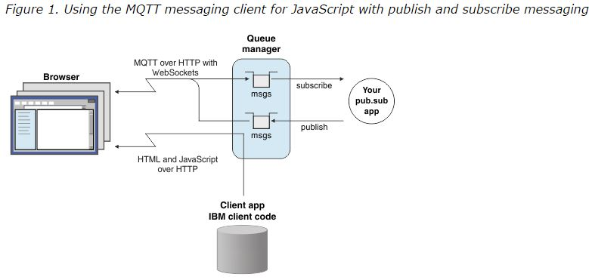
Message Queue Telemetry Transport (MQTT)

Slide 26
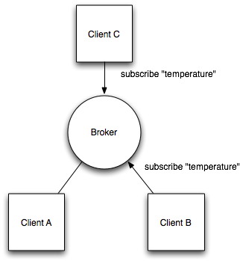
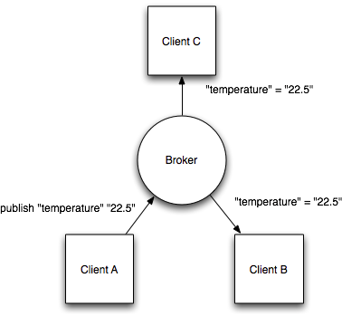
Message Queue Telemetry Transport (MQTT)
client/server model, where every sensor is a client and connects to a server, known as a broker, over TCP.
Mosquitto MQTT broker

Slide 27
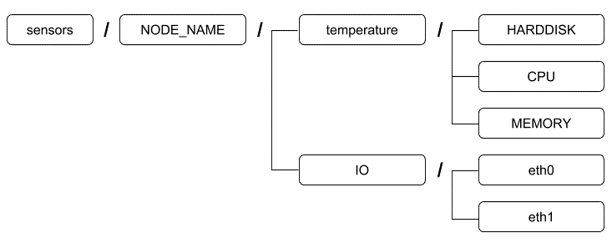
Message Queue Telemetry Transport (MQTT)
Topic matching
Hierarchical architecture
e.g.) sensors for various state of computer components

Slide 28
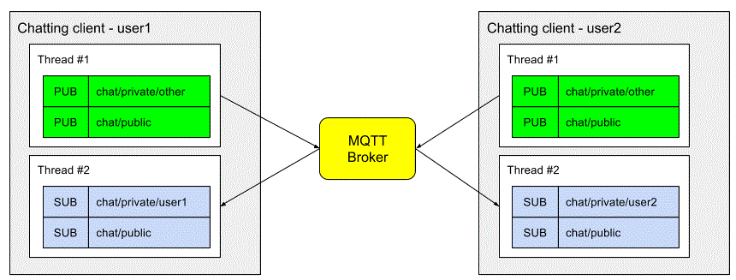
Message Queue Telemetry Transport (MQTT)
Chatting program

Slide 29
CoAP
Constrained Application Protocol from the CoRE (Constrained Resource Environments) IETF group.
Like HTTP, CoAP is a document transfer protocol. Unlike HTTP, CoAP is designed for the needs of constrained devices.
Open IETF Standard
Compact 4-byte Header
UDP, SMS, (TCP) Support
Strong DTLS Security
Asynchronous Subscription
Built-in Discovery
* Datagram Transport Layer Security (DTLS)

Slide 30
CoAP
From Web Applications to IoT Nodes
Web Application
* Datagram Transport Layer Security (DTLS)

Slide 31
CoAP
Embedded web transfer protocol (coap://)
Asynchronous transaction model
UDP binding with reliability and multicast support
GET, POST, PUT, DELETE methods
URI support
Small, simple 4 byte header
DTLS based PSK, RPK and Certificate security
Subset of MIME types and HTTP response codes
Built-in discovery
Optional observation and block transfer
* Datagram Transport Layer Security (DTLS)

Slide 32
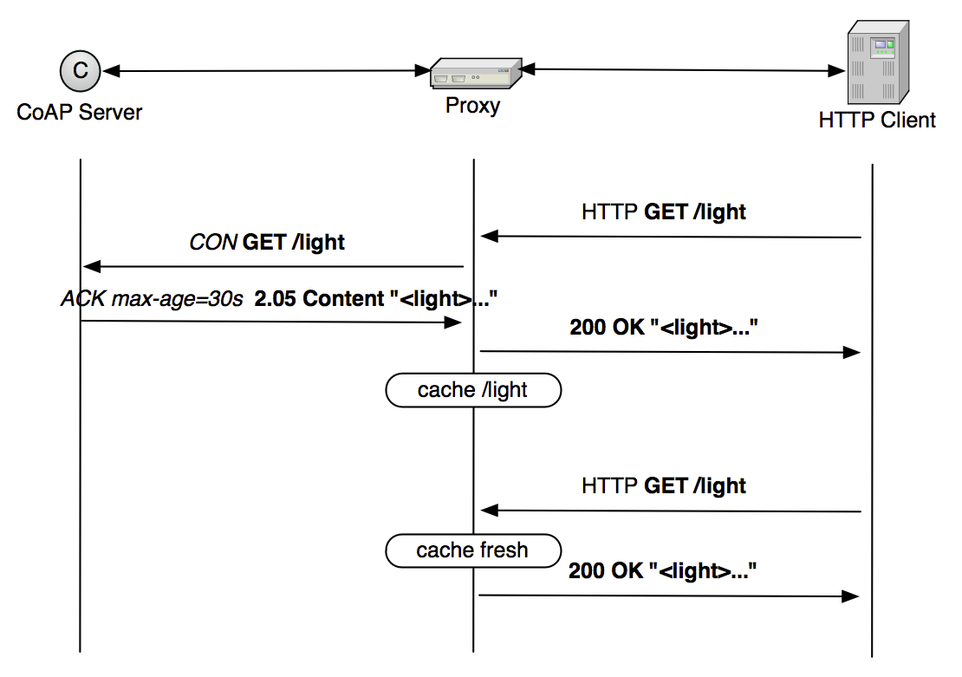
CoAP: Proxying and caching

Slide 33
CRUD, MVC and REST
CRUD: Create, Read, Update and Delete
the four basic functions of persistent storage
HTTP: Post, Get, Put, Delete
Let users deleting stuff from our server? Yes, not page but records in a database (items in shopping cart)
Data: (usually in the templates)
application data: user account data, shopping items
State information: whereabouts the user is in the myriad pathways through the application
Layout templates
e.g. HTML, CSS
Name: Young Lee
Email: yhlee@..
Profile: a….
Page is displayed in browser
Web server runs software to build page from template and database
Database stores the data that is used to fill the templates on a per user basis

Slide 34
CRUD, MVC and REST
MVC: Model-View-Controller: Model to architect the solution
Controller
Controls and co-ordinate any request from a Web browser, get /shopping
Interpret what the user is trying to do, then co-ordinates all server side activity
View
View block of code constructs the view combining a pre-programmed template
doesn’t interact with database directly
Model
Speaks CRUD verbs to the database
Actual object being modeled , a shopping cart in the figure
Interface may be: add an item, get an item, get the total price…
CONTROLLER
get /shopping
MODEL
Cart contents
Products/prices
http://myapp.com/shopping
Web server
Database server
VIEW
Template to show cart contents

Slide 35
CRUD, MVC and REST
Name
text
Email
text
REST: Representational State Transfer
Http://myshoppingstuff.com/cart/13764
myshoppingstuff.com : web site
/cart : “cart” controller
/13764 : unique id for an item
URL pattern matching and HTTP verb selection to fire the appropriate response at the server is extended to all controller
GET http://myshoppingstuff.com/catalogue/13764 - fetch information
GET http://myshoppingstuff.com/account/324asdve134 - fetch account information
POST http://myshoppingstuff.com/account/324asdve134 - update account information
information to update the account comes from a form in the Web page POST Http://myshoppingstuff.com/cart/13764
x : POST http://myshoppingstuff.com/cart/add-first-item/13764 , POST Http://myshoppingstuff.com/cart/add-second-item/13764 …
Changing state is the role of server: not shared by client: network disconnection, caching..
Each request from any client contains all of the information necessary to service the request, and any session state is held in the client.
Technique of mapping URLs directly onto actionable CRUD requests that update state in the Web server : an example of REST
This stateless approach makes the Web very scalable and
easier to program for.
REST way of accessing data via Web server : RESTful
Extended to enable data to be accessed in the raw,
without Web page : called API
Driving a lot of exciting activity on the Web right now
Card No.
number
Example of Web form
Facebook’s social API
GET http://graph.facebook.com/559089368
This returns
{
“id” : “559089368”,
“name” : “Paul Golding”
“first name” : “Paul”
….
}

Slide 36
Internet of Things
Web: means to link from one piece of content to another
Link page to page
Web 2.0 evolution:
Transformation of the link from a page-pointer to a data-pointer
Manipulate data pointed to by a URI
Uniform Resource Indicator (URI)
As locator (URL) or as Name (URN) or both
If you type
http://graph.facebook.com/1113552728
HTTP GET command returns a set of data formatted with JSON*
{
"id": "1113552728",
"name": "Younghee Lee",
"first_name": "Younghee",
"last_name": "Lee",
"link": "http://www.facebook.com/people/Younghee-Lee/1113552728",
"gender": "male",
"locale": "ko_KR"
} *JSON: JavaScript Object Notation

Slide 37


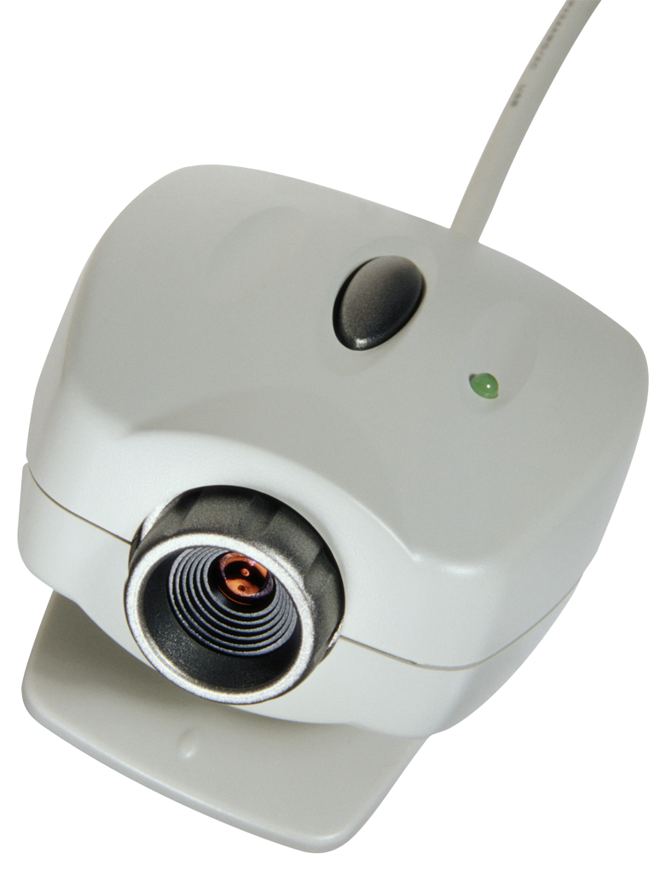
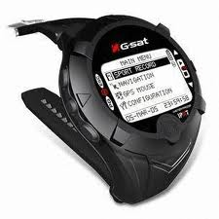

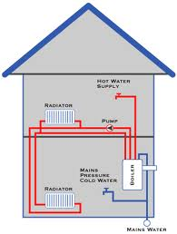
Internet of Things
http://graph.telco.com/01086787347
http://bmw.com/car/45665652728
http://sony.com/videocamera/98765478527
http://rolex.com/watch/798797854641
http://city.com/lights/16543379988
http://myhouse.com/boiler/1113552728
Not just pages : It’s data!
Structured data that represents a thing
Person, a car, a video camera, a watch….
Internet of Thing
We have many objects to connect with, manage and organize online
API
API
API
API
API

Slide 38
Internet of Things
Standard way to pay toll charges for cars, parking charges etc.
“Utility” type services
: Control mechanisms for granting access to data
Control who can access my data from car
: strategically important position in emergent battles to define and dominate the Web OS
Who will be the clear winner? Commercially and technologically including standard
Telco????
IoT => next Web, or Web 3.0?
Web3.0: IoT + α ----→ α is
app
app
app
Web OS
?
?
?
?
?
API
API
API
Data semantics, relationships

Slide 39

Data Semantics
http://graph.telco.com/01086787347
All data is accessible by above link
telco
{
"id": “0103552728",
"name": "Younghee Lee",
"first_name": "Younghee",
"last_name": "Lee",
"link": "http://www.telco.com/people/Younghee-Lee"
}
Online ordering
{
"id": “8345552728",
"node": "Younghee Lee",
“order": “WQ183434332",
“package": “Geko",
“status": “pending"
}
Movie
{
“data": [
{
“id”: 57,
“title": “Woodman, The (2004)”
},
{
“id”: 59,
“title": “Wild Things The (1998)”
}
// tons of movies here….]
}
API
API
API
Can be different person with the same name?
Title?, meaning of data?
semantics?
Web 3.0, semantic Web
Meta data:
Annotation about the data
API
API

Slide 40
Meta-Data Tools
Legacy Problem
Lots of data that isn’t labelled and isn’t about to be labelled soon
What to do?
For new data
Resource Description Framework : RDF
Tagging and Folksonomies
RDFa – embedding meta-data within Web pages
Twitter Annotations “Twannotations”

Slide 41
Meta-Data Tools: Ontologies, OWL, RDF
Resource Description Framework : RDF
Formal name for linked data on the Web
Links : Uniform Resource Indicators: URI
a framework for describing and interchanging metadata (data describing the web resources): allows
better precision in resource discovery than full text search,
assisting applications as schemas evolve,
interoperability of metadata.
A means to describe linked data
Allows ontologies to be constructed about linked data
Ontology
A formal representation of the knowledge about
set of concepts within a domain
And the relationship between those concepts
OWL: Web Ontology Language
a family of knowledge representation languages for authoring ontologies.

Slide 42
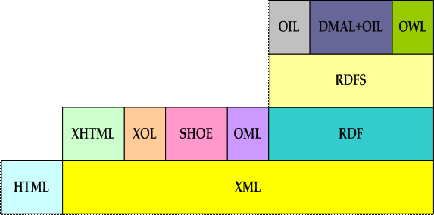
The Semantic Stack and Ontology Languages
B
A
The Semantic Language Layer for the Web
From “The Semantic Web” technical report by Pierce
A = Ontology languages based on XML syntax
B = Declarative ontology languages build on top of RDF and RDF Schema
Source: Mehmet Aktas, Marlon Pierce,
“Semantic Web and RDF Ontologies”, Indiana University

Slide 43
Meta-Data Tools: RDF
RDF has following important concepts
Resource : The resources being described by RDF are anything that can be named via a URI.
Property : RDF entities are built up out of properties and their associated values. A property is also a resource that has a name, for instance Author or Title.
Statement : A statement consists of the combination of a Resource, a Property, and an associated value.
Source: Mehmet Aktas, Marlon Pierce,
“Semantic Web and RDF Ontologies”, Indiana University

Slide 44
Meta-Data Tools: RDF, Example
Alice is the creator of the resource http://www.cs.indiana.edu/~Alice.
Property
Resource
Property Value
creator
=
http://purl.org/dc/elements/1.1/creator
http://www.cs.indiana.edu/~Alice
Alice
Property “creator” refers to a specific definition. (in this example by Dublin Core
Definition Standard). So, there is a structured URI for this property. This URI makes this
property unique and globally known.
By providing structured URI, we also specified the property value Alice as following.
“http://www.cs.indiana.edu/People/auto/b/Alice”
Source: Mehmet Aktas, Marlon Pierce,
“Semantic Web and RDF Ontologies”, Indiana University

Slide 45
RDF Schema (RDFS )
It resembles object-oriented programming
RDF Schema is a rules system for building RDF
languages.
RDFS is an extension of Resource Description
Framework.
RDFS provides a higher level of abstraction
than RDF.
specific classes of resources ,
specific properties,
and the relationships between these properties and other resources can be described.
RDFS allows specific resources to be described as instances of more general classes.
Also, RDFS provides important semantic capabilities that are used by enhanced semantic languages like DAML, OIL and OWL.
Resource
Class
Property
Literal
DataType
XMLLiteral
Instance Of:
Subclass Of:
Source: Mehmet Aktas, Marlon Pierce,
“Semantic Web and RDF Ontologies”, Indiana University

Slide 46
Meta-Data Tools: RDF
RDF is the simplest of the semantic languages.
Basic Idea #1: Triples
RDF is based on a subject-verb-object statement structure.
RDF subjects are called classes
Verbs are called properties or predicate
Basic Idea #2: Everything is a resource that is named with a URI
RDF nouns, verbs, and objects are all labeled with URIs
Recall that a URI is just a name for a resource.
It may be a URL, but not necessarily.
A URI can name anything that can be described
Web pages, creators of web pages, organizations that the creator works for,….
A predicate must always be a Uniform Resource Identifier.
Source: Mehmet Aktas, Marlon Pierce, “Semantic Web and RDF Ontologies”, Indiana University

Slide 47
Meta-Data Tools: Ontologies, OWL, RDF
This field is a contact
Tiger@wirelesswanders.com is an email address
Tiger Woods is a person
Lee Westwood is a friend
Item 3 seems obvious to human. To a computer, “Tiger Woods ” can be a Tiger or Woods.
This field is a contact of Tiger Woods
Tiger@wirelesswanders.com is an email address of Tiger Woods
Predicate is useful for expressing relationships enabling us to link subject to object
This field is a contact of http://tigerwoods/person
This field is an address of type http://hcard.com/rdf
Item 1 statement enables the S/W to follow the link to a definition of Tiger Woods as a person, whatever that means
Item 2 statement shows a link to an RDF file that explains what hCard is

Slide 48
Meta-Data Tools: Ontologies, OWL, RDF
The author of http://wirelesswanders.com is Tiger Woods
Predicate subject object
<?xml version=“1.0”?>
<RDF>
<Description about=“http://www.wirelesswanders.com”>
<Author>Tiger Woods</author>
<homepage>http://www.w3schools.com</homepage>
</Description>
</RDF>
Computer can read this format
RDF is also serialization of the OWL
OWL describe in a way that machine on the Web can better understand the meaning of data
a family of knowledge representation languages for authoring ontologies.
S/W can navigate and consume linked data based on inferred and expressed meaning
Web of ontology

Slide 49

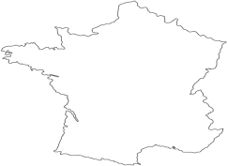

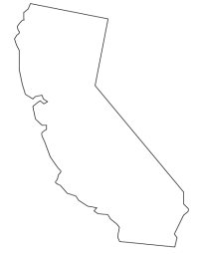

Meta-Data Tools: Ontology
“Ontology” is an often used term in the field of Knowledge Representation, Information Modeling, etc.
For common understanding and enabling reuse
English definitions tend to be vague to non-specialists
“A formal, explicit specification of a shared conceptionalization”
Clearer definition: an ontology is a taxonomy combined with inference rules
T. Berners-Lee, J. Hendler, O. Lassila
Which wine should I serve with seafood
today?
French wines and wine regions
A shared
ONTOLOGY
of
wine and food
California wines and wine regions
Source: Mehmet Aktas, Marlon Pierce,
“Semantic Web and RDF Ontologies”, Indiana University

Slide 50
Meta-Data Tools: Tagging and Folksonomies
RDF, OWL: Good but domain of computer programmers
Ordinary user? Too difficult
Tagging
Photo sharing site: Flickr
Users upload pictures and are then invited to tag them
“Lee, beach, sun, California, kids,…”
Slideshare – for tagging uploaded slide shows
YouTube – for tagging of contributed content
Gmail – tagging of mail messages
Easy and fun, no rules
Folk use them how they like => emergence of “Folksonomy”
Folk + Taxonomies (a bunch of terms used to classify stuff)
Can improve search a lot : e.g. beach : hard with pattern detection

Slide 51
Meta-Data Tools: Tagging and Folksonomies
Folksonomies emerge in large communities
A lot of tagging going on and on
Over time, patterns in the tags emerge => taxonomy to take shape
Tags are too informal, too poorly structured, too ambiguous
e.g) Mobile: what does it mean? Phone?, camera? ???
Same tag with different meaning(homonyms) or multiple tag for same idea (synonyms)
Leads to inefficient searches
Tag triples?
subject:predicate:object expression or more of resource:property:value
Users are extremely reticent to expend any efforts in adding information
Useful but likely remain niche
RDF, OWL <= platform power

Slide 52
Meta-Data Tools: RDFa
RDFa – Embedding Meta-Data within Web Pages
Half way between tagging and RDF
At least for adding semantics to Web pages
Giving Web page developers a means to tag the HTML mark-up used to generate Web pages in browser
HTML mark-up allows a Web developer to control how a page is structured and displayed by the browser
<h2> Why tagging is important</h2>
<h3> By Paul Golding</h3>
Instead of a whole new approach to Web page
<h2 property=“title”>Why tagging is important</h2>
<h3 property=“author”>By Paul Golding</h3>
Only works with XHTML, eXtensible HTML (allow property extension)
How a S/W know what this extension mean?
Use RDF to construct a set of semantic for the domain -> host this RDF file at some URI -> point to it as the schema to use for property extension

Slide 53
Meta-Data Tools: Twannotations
Twitter annotations
Sematic expression limited due to the terse nature of tweets
Messaging bus for applications on the Web
Tweet from Twitter client
Tweet from inside other apps, such as Spotify, the music streaming app
Music track info and playlist info
The way to share real time messages about anything and between anything
A potentially significant role in the IoT
Not open standard or platform
Service A
Service B
Service B
API
API
API
T+2
T+1
T
T-1
T-2
Service A
Service B
Service B
API
API
API
Twitter as a universal messaging bus for Web apps

Slide 54
Meta-Data Tools: Twannotations
If it were possible for S/W to recognize certain tweets as being related to music, or film, or whatever, this would be interesting to the vast number of applications
Tweet about a book: good for Amazon tweet-outs,
Book news, reviews, offers …
About product: good for all kinds of services
About stock: But!, Sell!
….
140 character limit: starts with<text>, ends with </text>
The rest is the entire data structure of status update: much bigger
More fields can be added: annotations can be added in to the data structure easily => annotation-aware applications
Type: webpage, review, song, movie, tvshow…
Attribute: Title, URL, ID, Provider, Place_Type, Street-address ….
Twannotations will take Twitter innovation to a whole new level
Twitter : potentially default platform for connecting the IoT in real time

Slide 55
Reference
Paul Golding, “Connected Services” Wiley, Sep. 2011

Slide 56
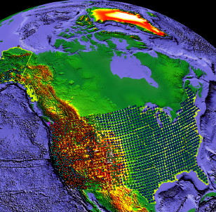
Sensor-Net: Web 3.0
Cloud based. “Big-Data” applications
Near real-time response
Initial image processing to take place locally(edge detection,…) + cloud
Real time storage
Real time Processing
Real time output
Distributed sensor grids
Cloud-based platform for processing sensor data

Slide 57
Sensor Networks: Applications
Examples;
high-rise buildings self-detect structural faults (e.g., weld cracks)
schools detect airborne toxins at low concentrations, trace contaminant transport to source
buoys alert swimmers to dangerous bacterial levels
earthquake-rubbled building infiltrated with robots and sensors: locate survivors, evaluate structural damage
ecosystems infused with chemical, physical, acoustic, image sensors to track global change parameters
battlefield sprinkled with sensors that identify track friendly/foe air, ground vehicles, personnel
Micro-sensors, on-board processing, wireless interfaces feasible at very small scale--can monitor phenomena “up close”
Embedded Networked Sensing will reveal previously unobservable phenomena

Slide 58
Overall Design of Sensor Networks
One possible solution?
Internet technology coupled with ad-hoc routing mechanism
Each node has one IP address. Each node can run applications and services
Application instances running on each node can communicate with each other
Why must it be different and difficult?
A sensor node is not an identity (address): Content based and data centric
Where are nodes whose temperatures will exceed more than 10 degrees for next 10 minutes?
Tell me the location of the object ( with interest specification) every 100ms for 2 minutes.
Multiple sensors collaborate to achieve one goal.
Intermediate nodes can perform data aggregation and caching in addition to routing.: where, when, how?
Not node-to-node packet switching, but node-to-node data propagation.
High level tasks are needed:
At what speed and in what direction was that elephant traveling?
Is it the time to order more inventory?

Slide 59
Classifications of Sensor Nets
Sensor position
Static (Habitat, CORIE, Biomedical)
Mobile (Smart Dust, Biomedical)
Goal-driven
Monitoring: Real-time/Not-real-time (Habitat, Smart Dust)
Forecasting (CORIE)
Function substitution (Biomedical)
…
Communication medium
Radio Frequency (Habitat, CORIE, Biomedical)
Light (Smart Dust)

Slide 60
Attribute based routing: Directed Diffusion
Elements of Directed Diffusion
Naming
Data is named using attribute-value pairs
Interests
A node requests data by sending interests for named data
Gradients
Gradients is set up within the network designed to “draw” events, i.e. data matching the interest.
Reinforcement
Sink reinforces particular neighbors to draw higher quality ( higher data rate) events

Slide 61
Interest Propagation
Flooding
Constrained or Directional flooding based on location.
Directional Propagation based on previously cached data.
Source
Gradient
Interest
Sink

Slide 62
Data Propagation
Reinforcement to single path delivery.
Multipath delivery with probabilistic forwarding.
Multipath delivery with selective quality along different paths.
Source
Gradient
Data
Sink

Slide 63
Reinforcement
Reinforce one of the neighbor after receiving initial data.
Neighbor(s) from whom new events received.
Neighbor who’s consistently performing better than others.
Neighbor from whom most events received.
Source
Gradient
Data
Reinforcement
Sink

Slide 64
Naming
Content based naming
Tasks are named by a list of attribute – value pairs
Task description specifies an interest for data matching the attributes
Animal tracking:
Request
Reply
Interest ( Task ) Description
Type = four-legged animal
Interval = 20 ms
Duration = 1 minute
Location = [-100, 100; 200, 400]
Node data
Type =four-legged animal
Instance = elephant
Location = [125, 220]
Confidence = 0.85
Time = 02:10:35

Slide 65
Interest
The sink periodically broadcasts interest messages to each of its neighbors
Every node maintains an interest cache
Each item corresponds to a distinct interest
No information about the sink
Interest aggregation : identical type, completely overlap rectangle attributes
Each entry in the cache has several fields
Timestamp: last received matching interest
Several gradients: data rate, duration, direction

Slide 66
6LowPAN
Billions of information devices embedded in the physical world => need good interworking protocol
Advantages of 6LowPAN
Extensive interoperability
Devices on any other IP network link (WiFi, Ethernet, GPRS, Serial lines,.)
Established security
Authentication, access control, and firewall mechanisms
Established naming, addressing, translation, lookup, discovery
Established proxy architectures for higher-level services
Mobility, HTTP/HTML/XML/SOAP/REST, Application profiles,network management tools, Ping, Traceroute, SNMP, … OpenView, NetManager, Ganglia,
Some part of this teaching materials (slides on LOAD/DYMO-Low) are prepared referencing the presentation materials made by Mr. David E. Culler ARCHROCK Corporation

Slide 67
6LowPAN
Challenges for IPv6 over 802.15.4
Header
Standard IPv6 header is 40 bytes [RFC 2460]
Entire 802.15.4 MTU is 127 bytes [IEEE ]
Often data payload is small
Fragmentation
IP packets may be large, compared to 802.15.4 max frame size
IPv6 requires all links support 1280 byte packets [RFC 2460]
Allow link-layer mesh routing under IP topology
802.15.4 subnets may utilize multiple radio hops per IP hop
Similar to LAN switching within IP routing domain in Ethernet
Allow IP routing over a mesh of 802.15.4 nodes

Slide 68
WSN (ZigBee) vs. IP-USN (6LoWPAN)
Data
Data
Application Layer
Application Layer
Application Layer
Transport Layer
(TCP/UDP)
Transport Layer
(TCP/UDP)
Application Support
Layer
Application Support
Layer
Network Layer
(IP)
Network Layer
(IP)
ZigBee Network
Layer
ZigBee Network
Layer
Ethernet of other
MAC
Ethernet of other
MAC
IEEE 802.15.4
MAC/PHY
IEEE 802.15.4
MAC/PHY
Host of IP network
ZigBee gateway
ZigBee Sensor node
Data
Data
Application Layer
Application Layer
Transport Layer
(TCP/UDP)
Transport Layer
(TCP/UDP)
Network Layer
(IP)
Network Layer
(IP)
Network Layer
(IPv6)
Ethernet of other
MAC/PHY
Ethernet of other
MAC/PHY
Adaptation Layer
Adaptation Layer
IEEE 802.15.4
MAC/PHY
IEEE 802.15.4
MAC/PHY
Host of IP network
Host of 6LoWPAN

Slide 69
Ad-hoc Routing protocols for 6LoWPAN
6LowPAN
Allow IPv6 routing over a mesh of 802.15.4 low power PAN
6LoWPAN Ad Hoc On-Demand Distance Vector Routing (LOAD)
draft-daniel-6lowpan-load-adhoc-routing-01.txt
Dynamic MANET On-demand for 6LoWPAN (DYMO-low) Routing
draft-montenegro-6lowpan-dymo-low-routing-00.txt
Large part of this teaching materials (slides on LOAD/DYMO-Low) are prepared referencing the presentation materials made by Prof. Ki-Hyung Kim for 6LoWPAN WG, IETF64, Vancouver

Slide 70
LOAD
LOAD
Internetworking routing protocol for multiple PAN
Simplified version of AODV
Use EUI-64 or 16 bit addresses
Do not use the destination sequence number
RERR back propagation
AODV: utilize the precursor list to reach the originators
LOAD: Send RERR only to the originator of link break using originator address

Slide 71
DYMO-Low
Dynamic MANET On-demand for 6LoWPAN Routing
Simplification from DYMO
DYMOcast is mapped as broadcast
no path accumulation
Possibly reduce the number of control messages by aggregation
Limit on the number of control message
Do not use HELLO message and Sequence Number

Slide 72
DYMO-Low

Slide 73
6LoWPAN Format Design

Slide 74
6LoWPAN IPv6 Header

Slide 75
6LoWPAN: compressed /UDP

Slide 76
6LoWPAN vs. Zigbee

Slide 77
WSN (ZigBee) vs. IP-USN (6LoWPAN)
Sensor Node (16bit ZigBee ID)
Sensor Node (IPv6 address)
Event DB
Coordinator
Coordinator
Event
Request / Response
Event
Update
Event
Request / Response
Monitoring Center
Sink Node
6LoWPAN Gateway
Monitoring Center
Breaking end-to-end transparency
Limited adaptation for generic Service Architecture
Monitoring Center

